Slide 1
Pi Mora 2.1
ECLUB

Slide 2
Todays Schedule
What is ETHICAL hacking ?
Why every one should know hacking ???
Modern Hacking Methods
A Challenge
Man In the Middle Attacks
Address resolution protocol
Domain name system
Python

Slide 3
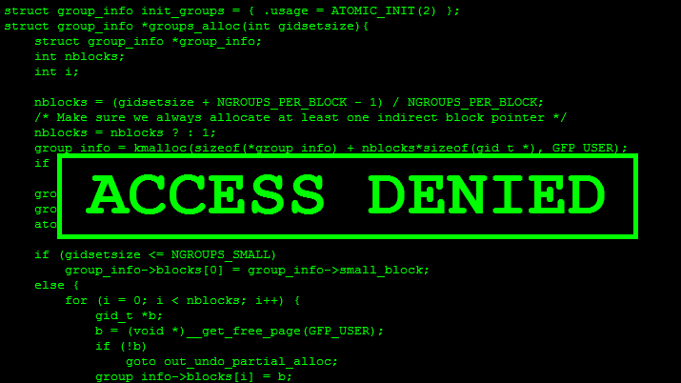
Hacking?

Slide 4

Information Gathering
Classify vulnerabilities
Plan the attack
Weeks
Testing
Months/Weeks
Weeks
3 Months / Years
02
01
03
Months/Weeks
Execute
Search for vulnerabilities
Research the vulnerabilities
Plan the Delivery

Slide 5
Why for YOU?

